Slide 1
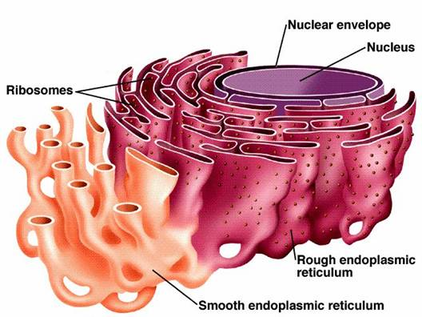
(ER)
Endoplasmic reticulum :
membrane bound,
Sheets
It is a large network of
tubes and sheets.
Covered by membrane
Tubes

Slide 2
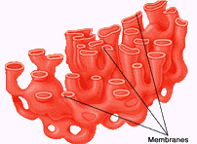
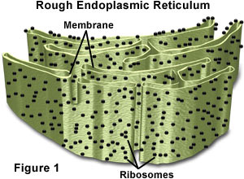
Endoplasmic reticulum :
is of two types
Rough endoplasmic reticulum (RER)
Smooth endoplasmic reticulum (SER)
It looks rough under an electron microscope.
It is without ribosomes
It manufactures fat molecules or lipids.
It has particles called ribosomes attached to it.
Ribosomes are site for protein synthesis.

Slide 3
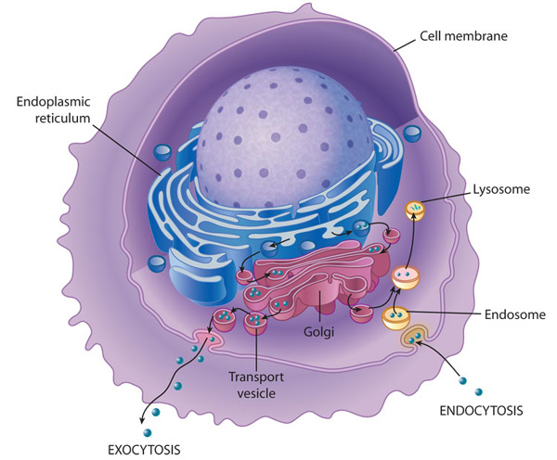
Functions of endoplasmic reticulum :
It helps in intracellular transport.
It synthesizes proteins and lipids (fats) and transports them.
Proteins and lipids synthesized by ER are used in building plasma membrane.
This process is known as membrane biogenesis.

Slide 4
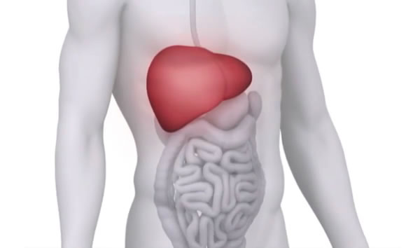

Functions of endoplasmic reticulum :
Some lipids and proteins are used as enzymes and hormones.
It transports proteins synthesized by ribosomes.
SER of certain cells of liver play a crucial role in detoxifying many poisons and drugs which enter our body through food, air or water.

